Slide 1
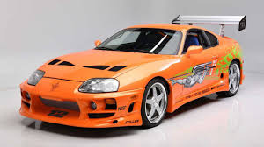
Toyota Used Car Market Insights
By: Colin Roy, Daniel Avelar, Braden Flynn, Mariano Del Castillo

Slide 2
Executive Summary
This report provides an exploratory/predictive analysis of 6,738 used Toyota-brand car records (potentially simulated data)
Exploration of the distributions of each of the 8 variables studied, as well as the correlation/relationships between these variables (made with the ggplot2 R library)
Construction of a predictive linear regression model to predict pricing
This analysis includes supporting queries using the sqldf R library that provide a deeper understanding of the patterns that appear in the visualisation/modeling component of the project
Notes:
Colin

Slide 3
Cleaning the Data
The Process
–Imputing various values to make the dataset more representative of vehicles listed
~6 vehicles with ‘0’ as the engine displacement -> replaced with 1 as it was the actual engine displacement for these models
-many vehicles with mpg over 70, some over 200
-Researched these vehicles and their values were replaced with 60 mpg to be closer to the truth
The Starting Point
-6,738 records
-8 usable variables
-no null/NA values but some inaccurate zeroes among other inflated/erroneous values in the tax (not used), mpg, and engineSize variables
The End Result
(What was removed/Lost)
-No records were deleted, but the tax column was not used for any analysis due to the geography/location of data collection not being listed
Notes:
Colin

Slide 4
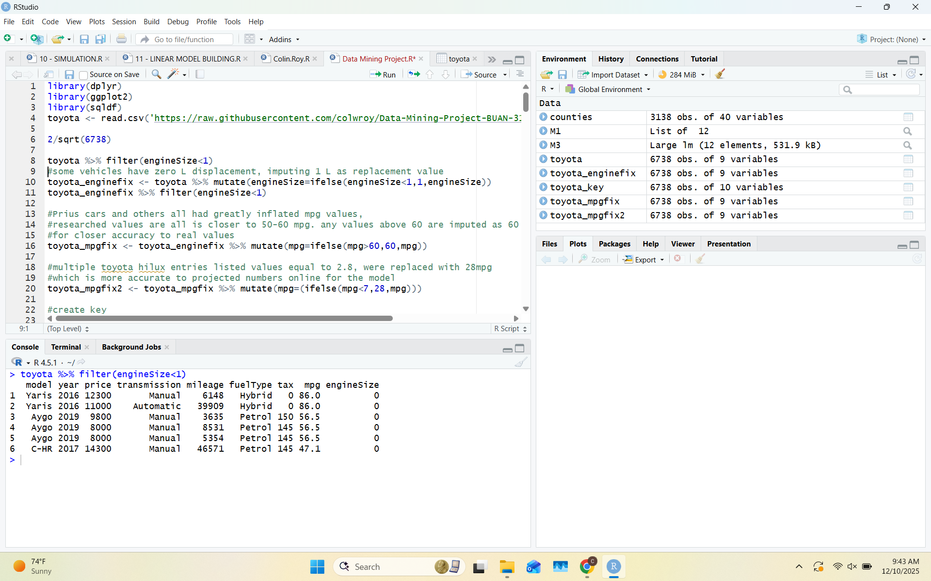
Cleaning The Data (2)
Notes:
Colin

Slide 5
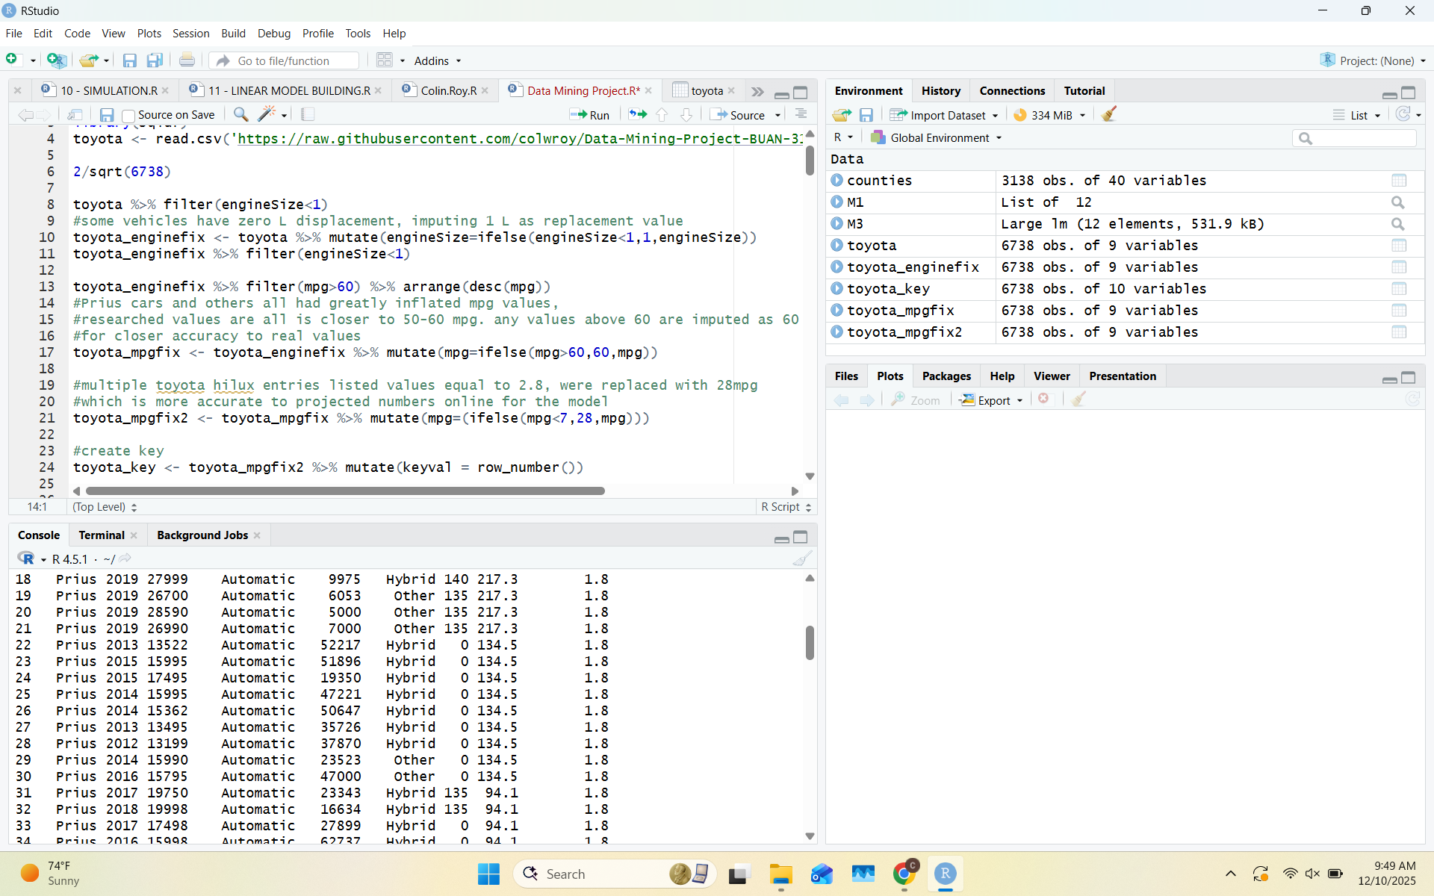
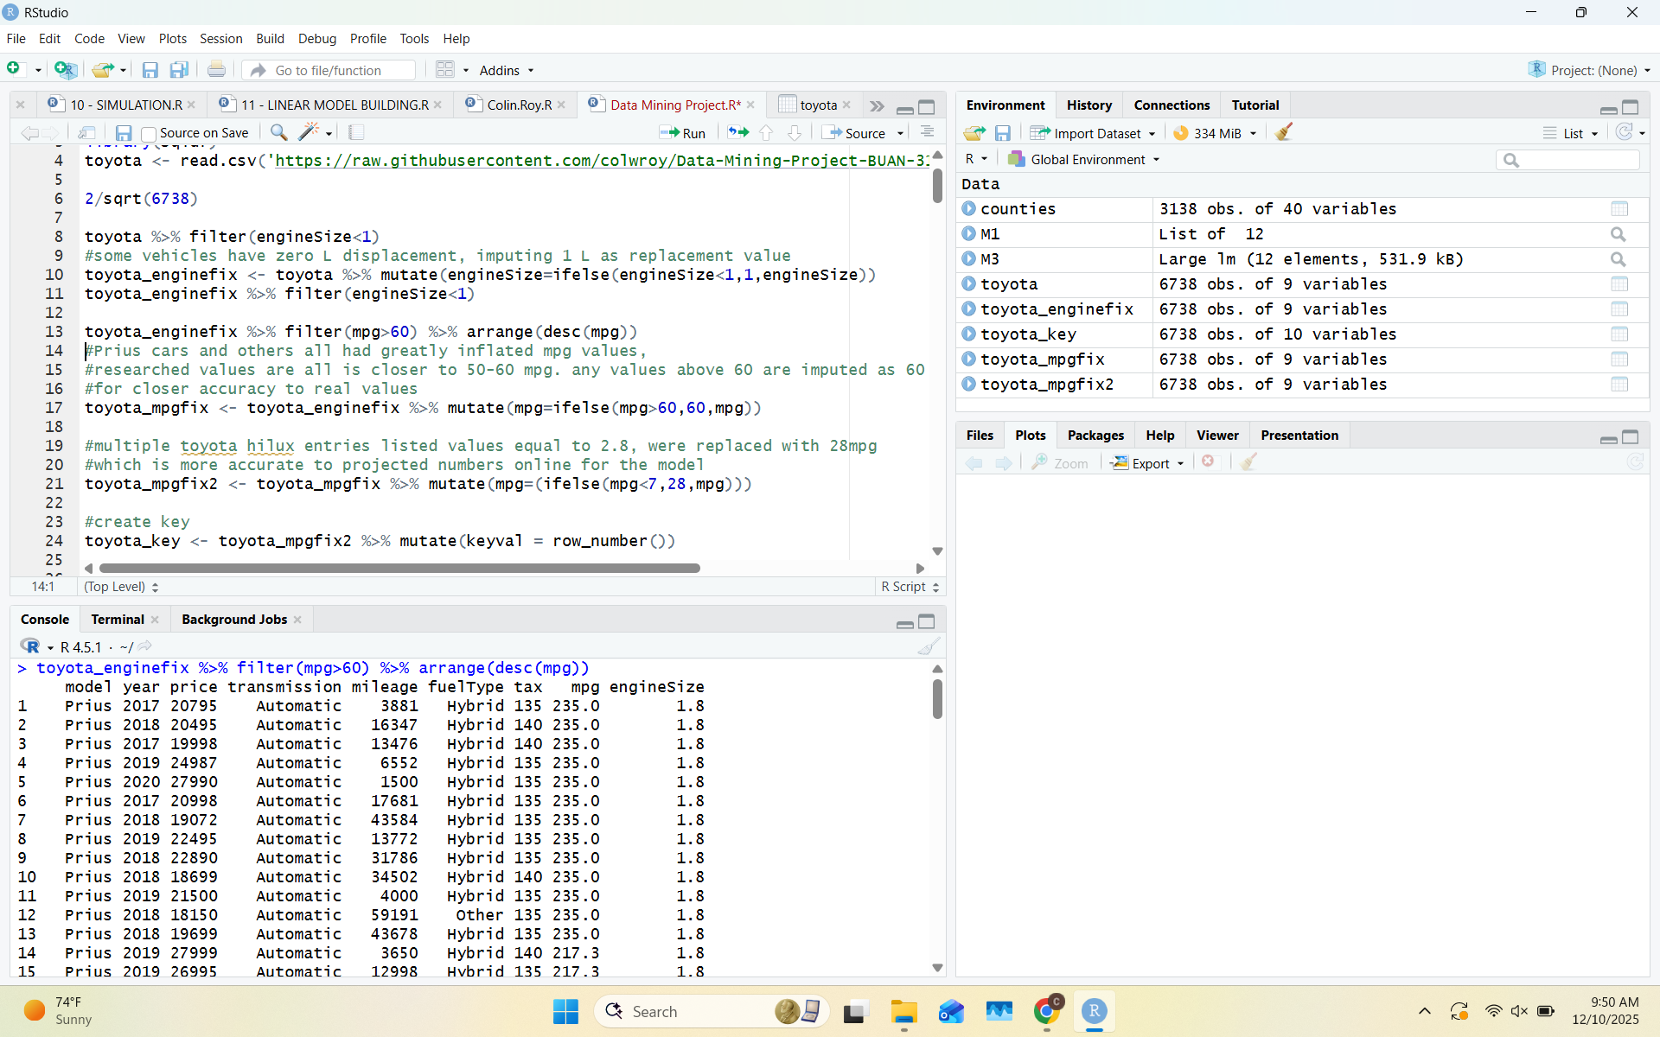
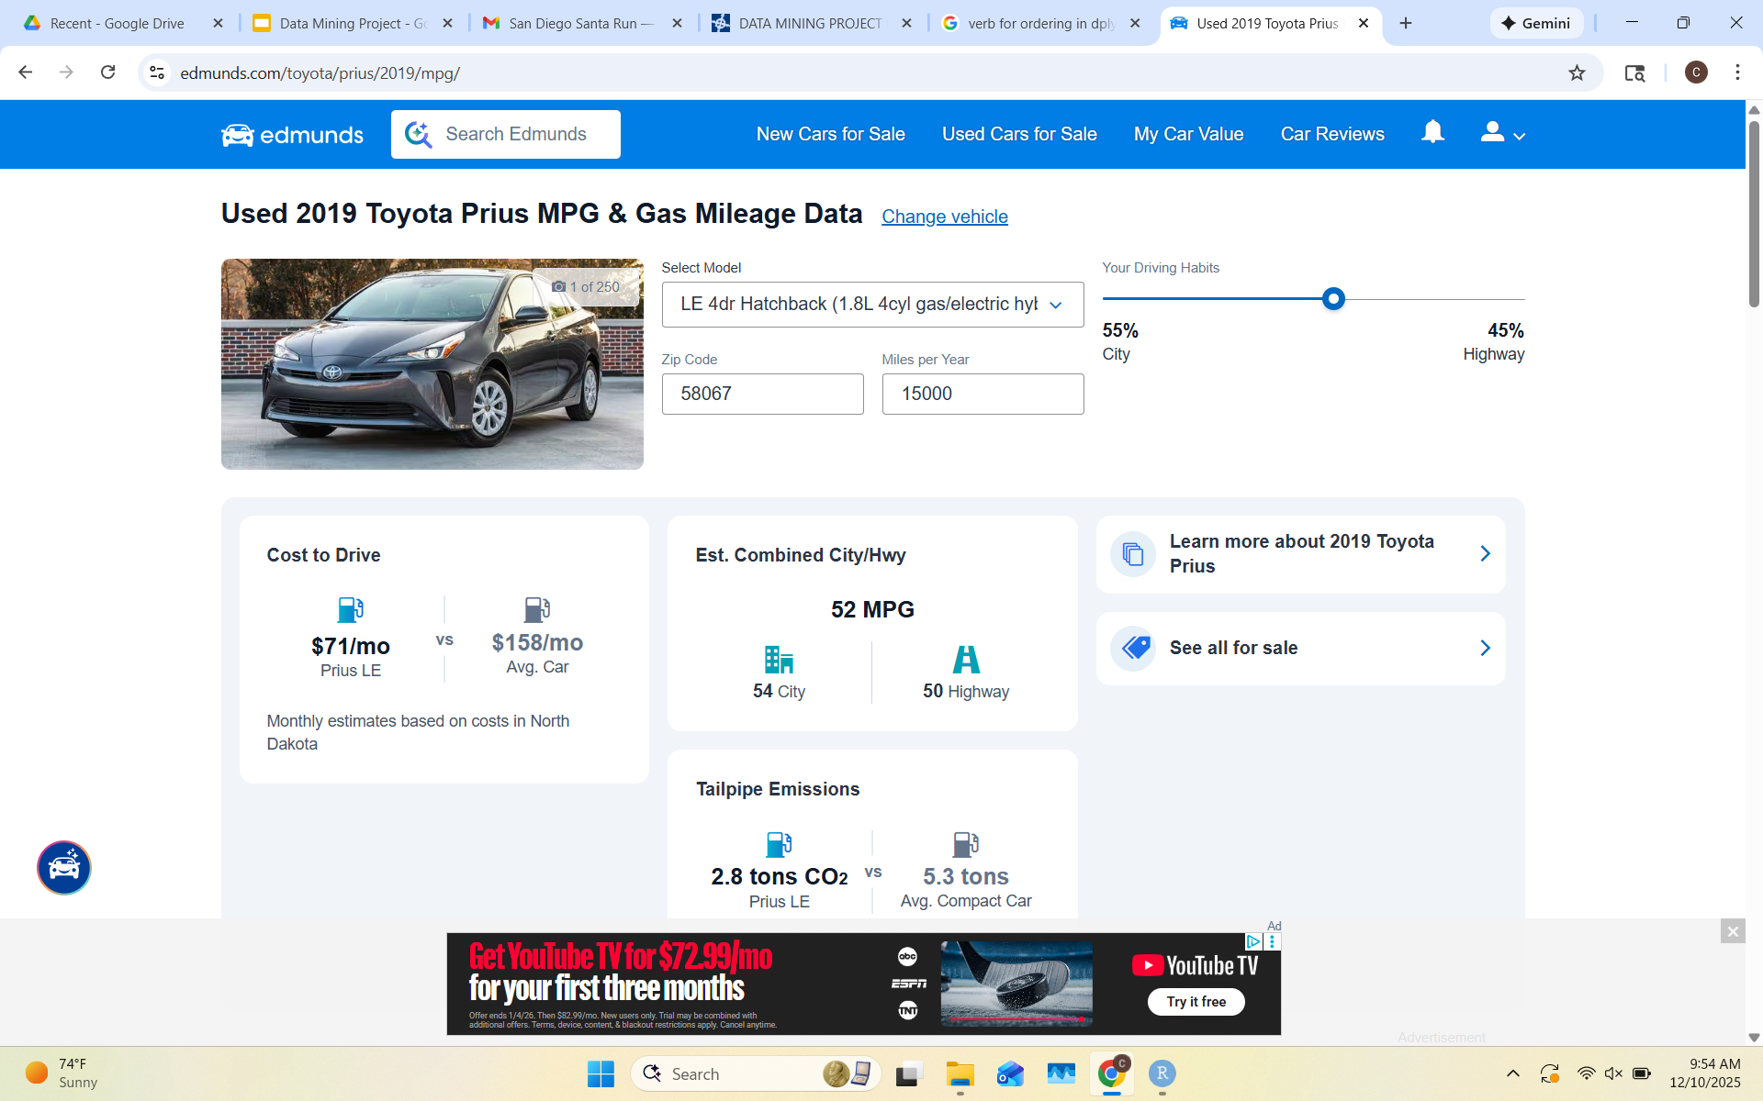

Cleaning The Data (3)
Notes:
Colin

Slide 6
The Story Our Data Tells
Our Data Visualisations: Descriptive Analysis
(With the code attached)
Notes:
Colin

Slide 7
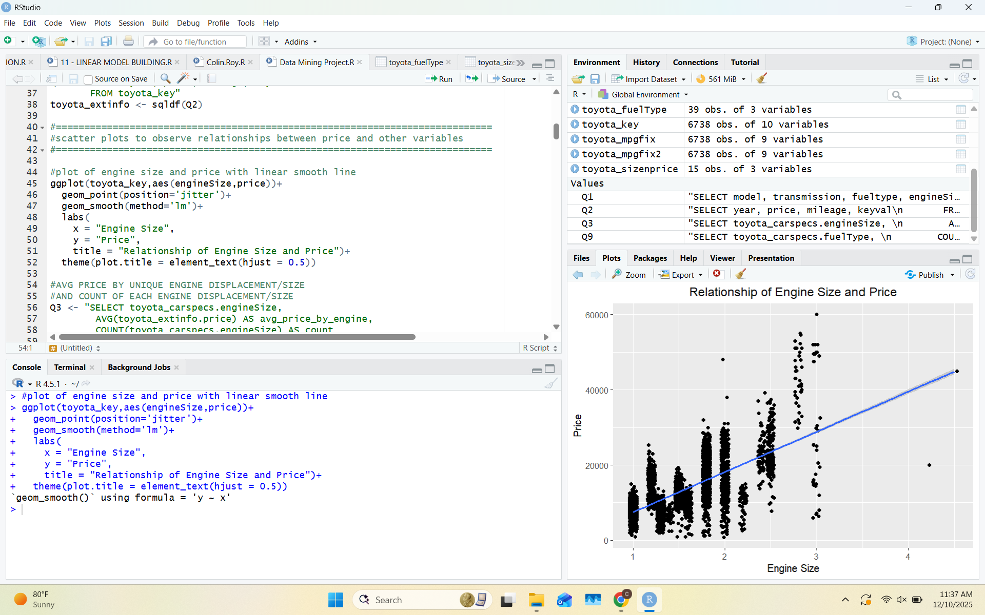
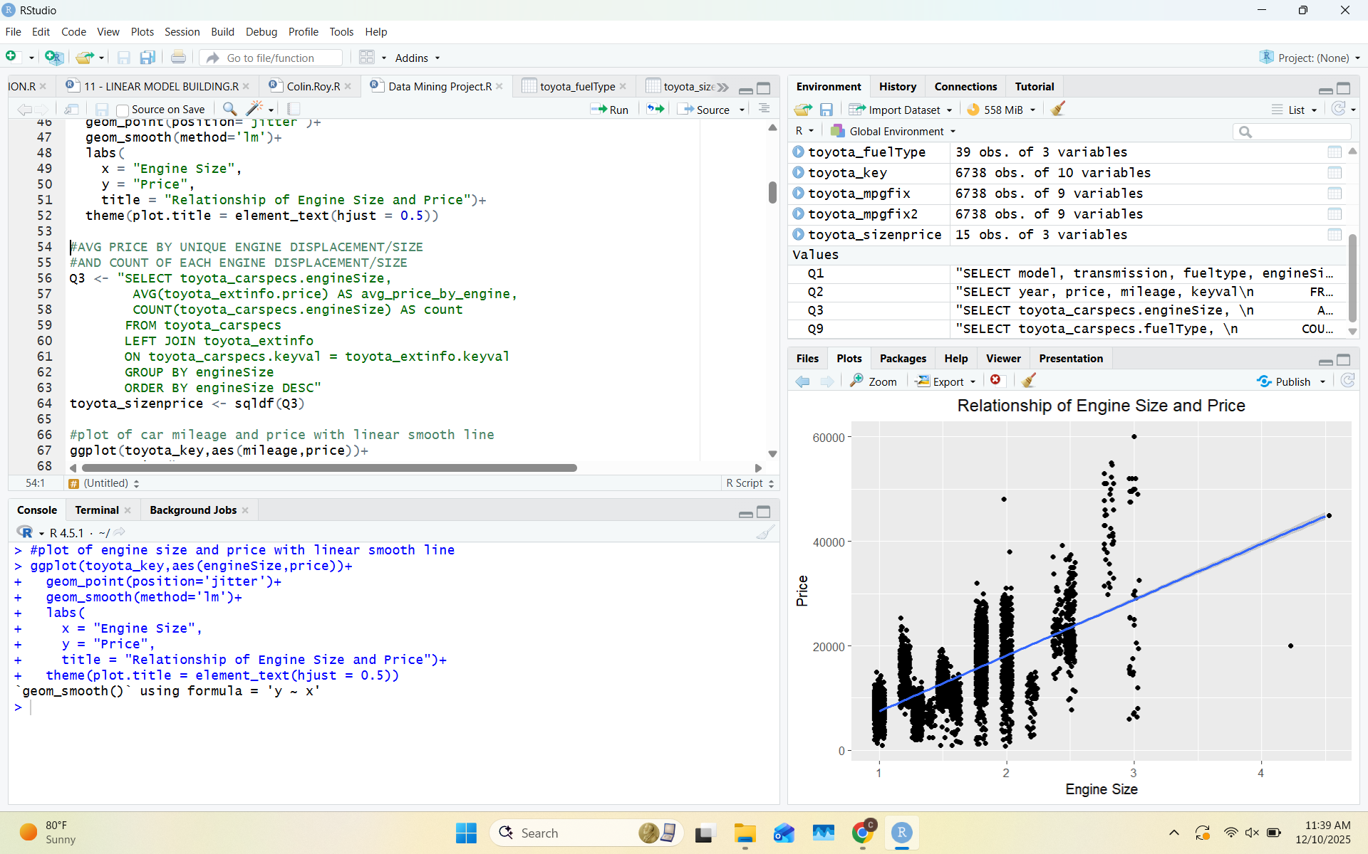
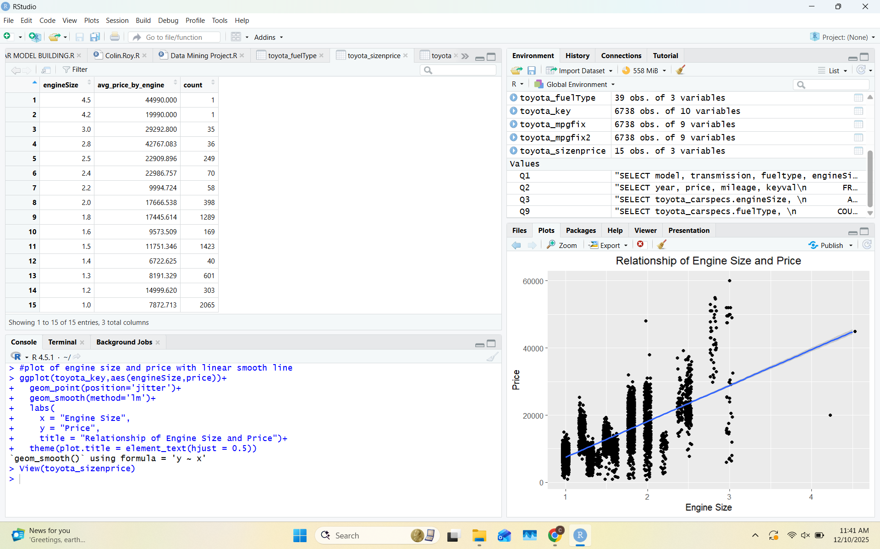
Visualization 1:
Supporting Query
Key Insight(s)
-Positive correlation between engine size/displacement and vehicle price
-large amount of variability in price for each engine size
-visible groups of values for each engine size
Notes:
Colin

Slide 8
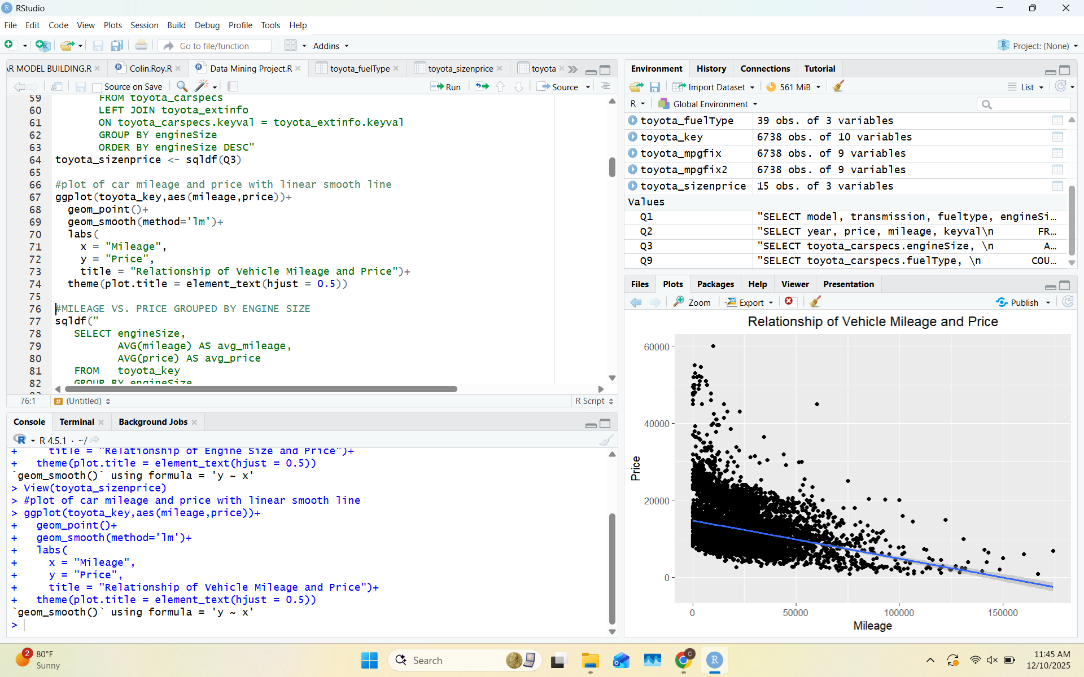
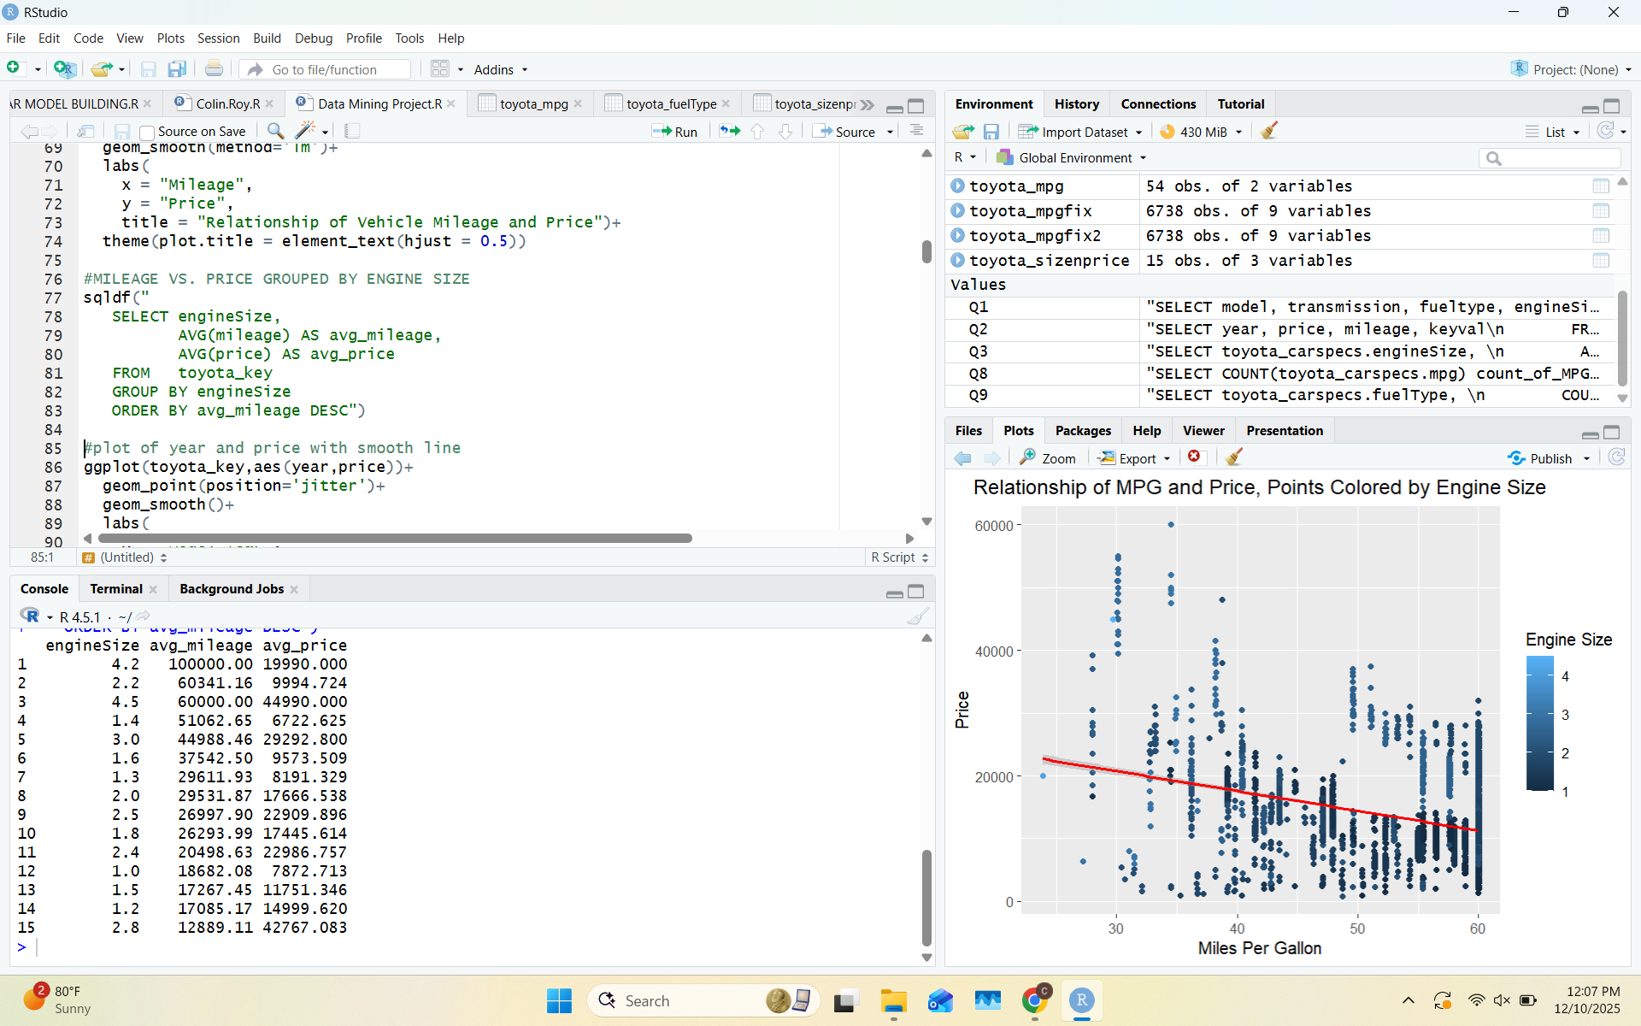
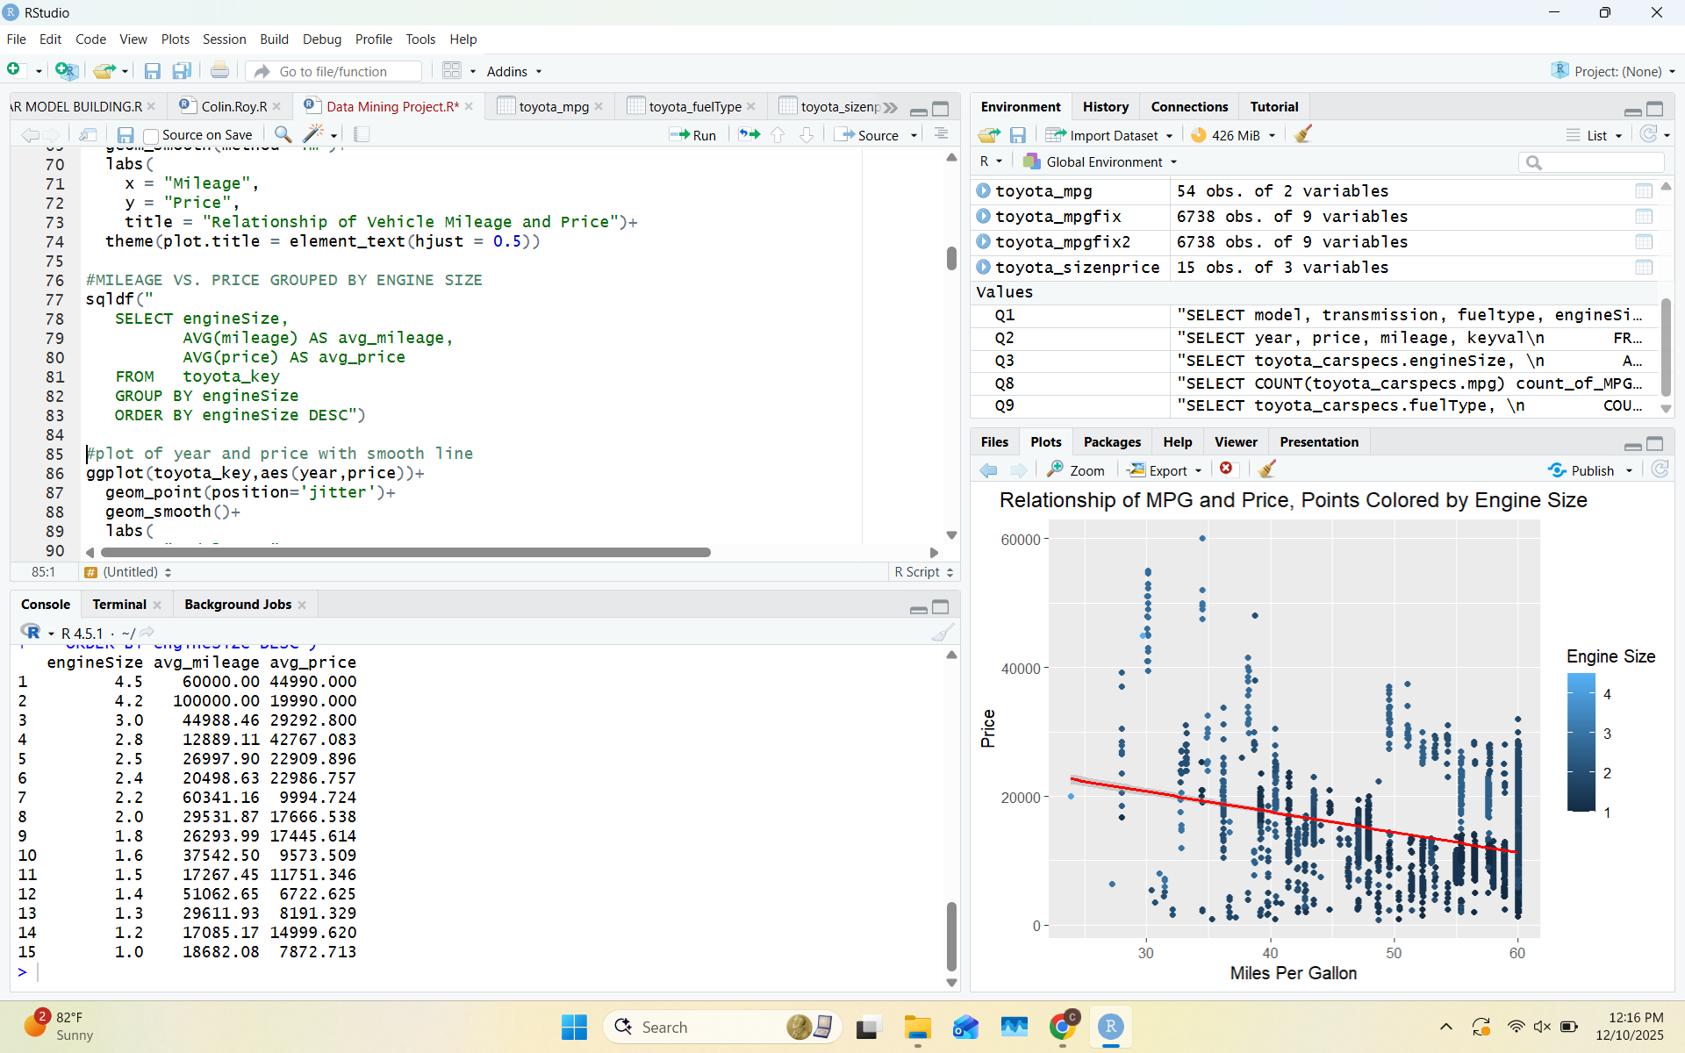
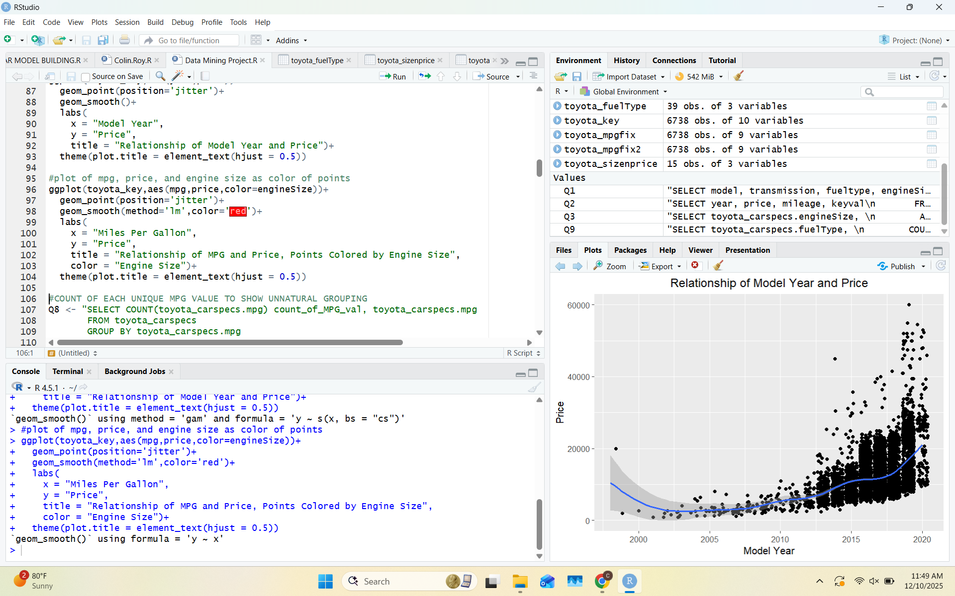
Visualization 2:
Supporting Query
Key Insight(s)
-Slight negative relationship between vehicle mileage and price
-model year and price have a slight positive relationship
-based on the query, larger engines appear to generally have more miles on them than smaller engines (possibly due to older cars having larger engines?)
Notes:
Mariano

Slide 9
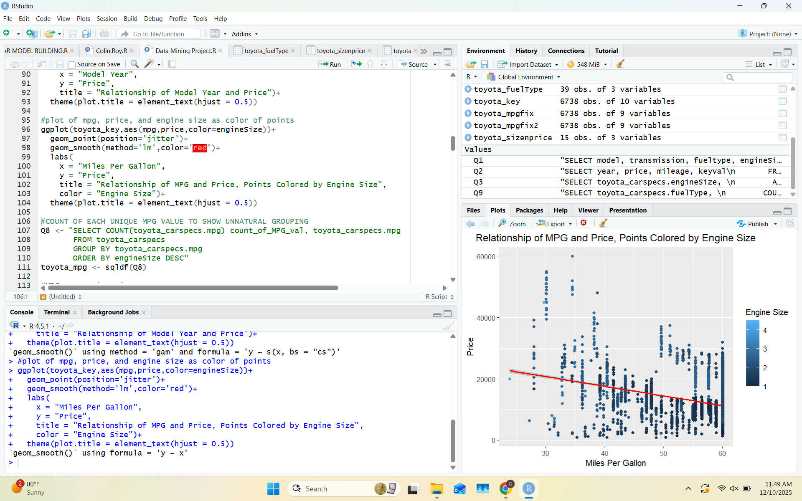
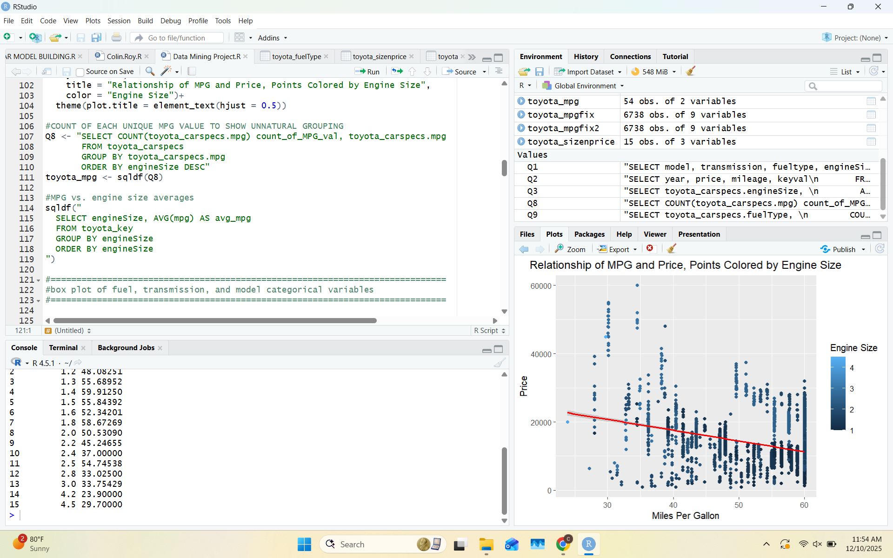
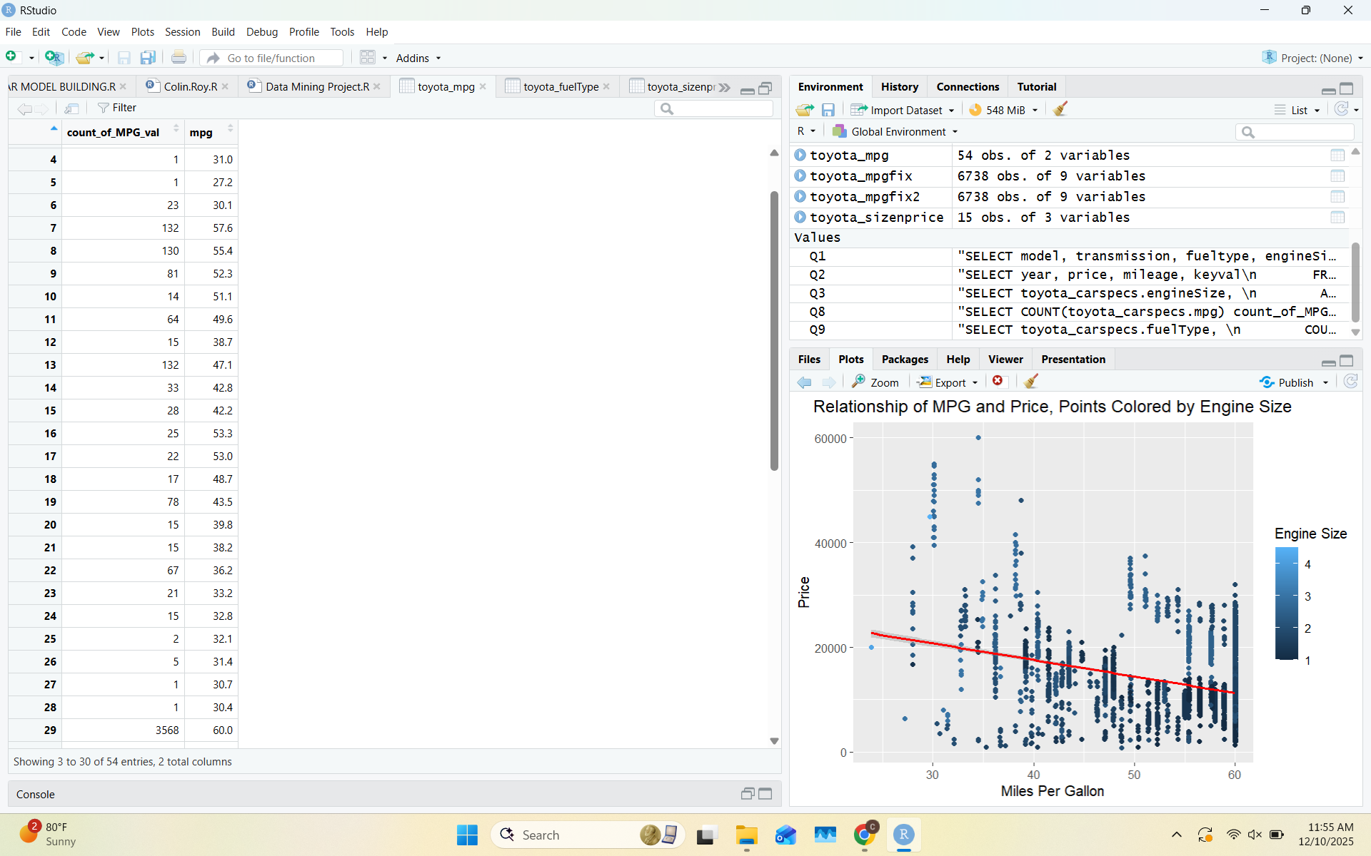
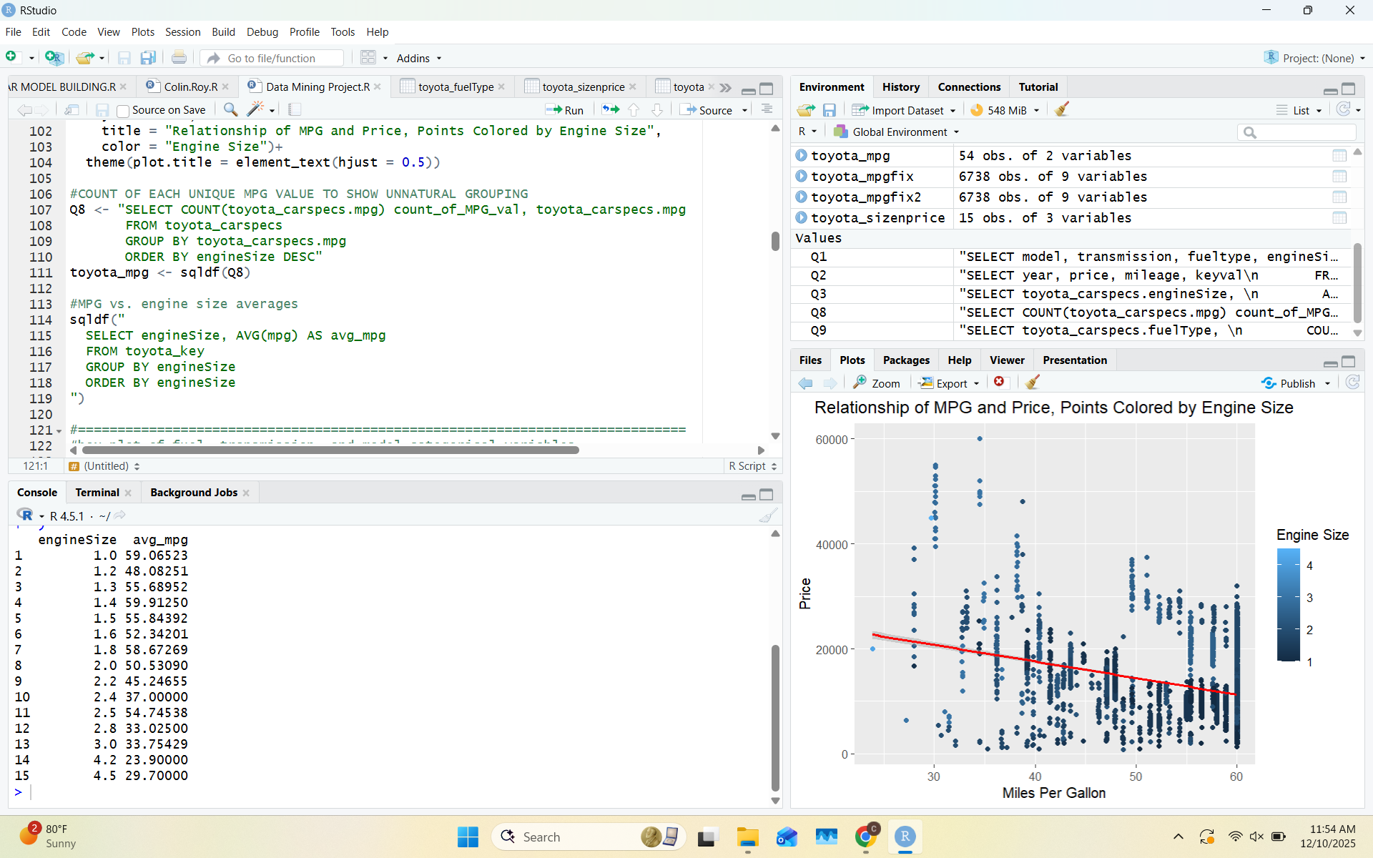
Visualization 3:
Supporting Query
Key Insight(s)
-mild negative correlation between miles per gallon and price
-smaller engines tend to have higher miles per gallon (observe dark blue cluster on bottom right portion of graph
-odd grouping of mpg values, giving the impression that the data may have been generated and not organically sampled
Notes:
Mariano

Slide 10
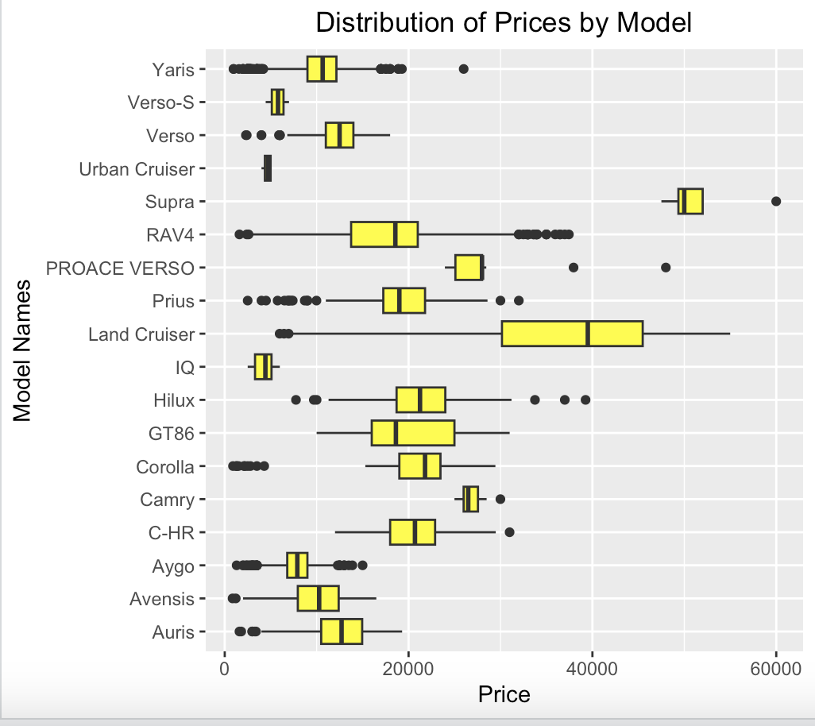
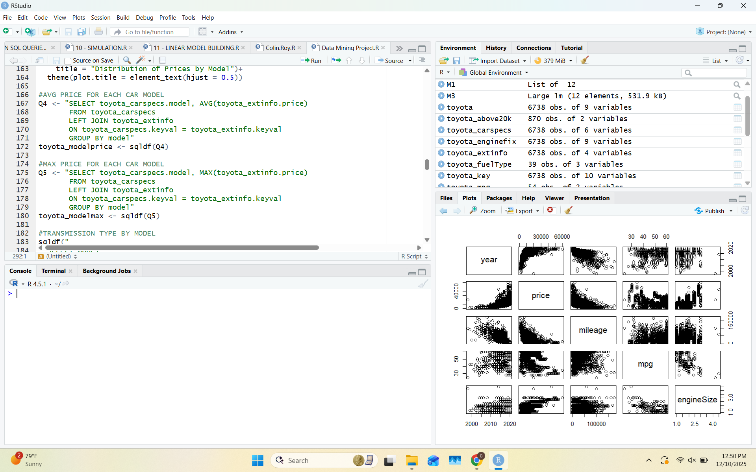
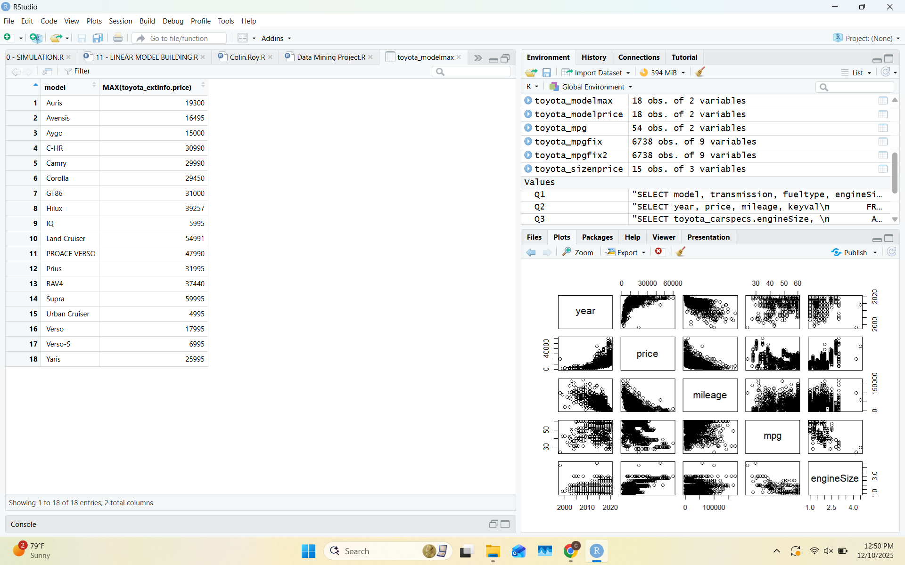
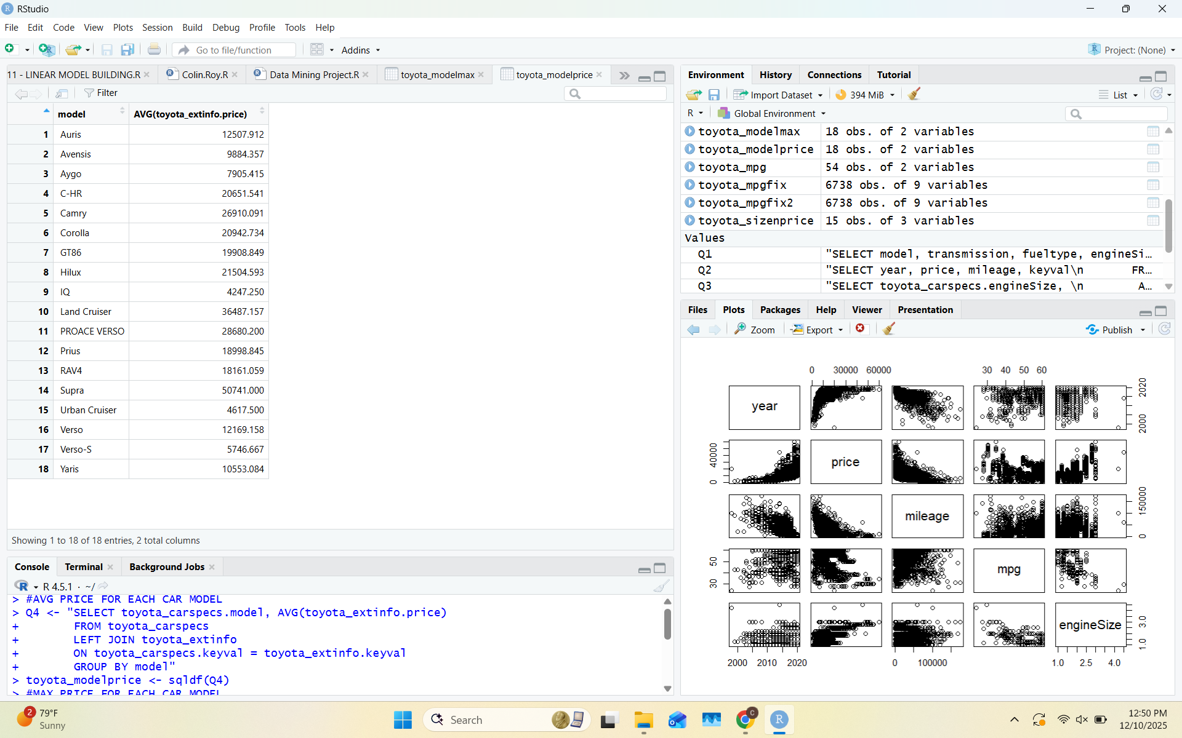
Visualization 4:
Supporting Query
Key Insight(s)
-Supra and Land cruiser are consistently the most expensive models
-IQ, Urban Cruiser, and Verso-S are the lowest price models
Notes:
Mariano

Slide 11
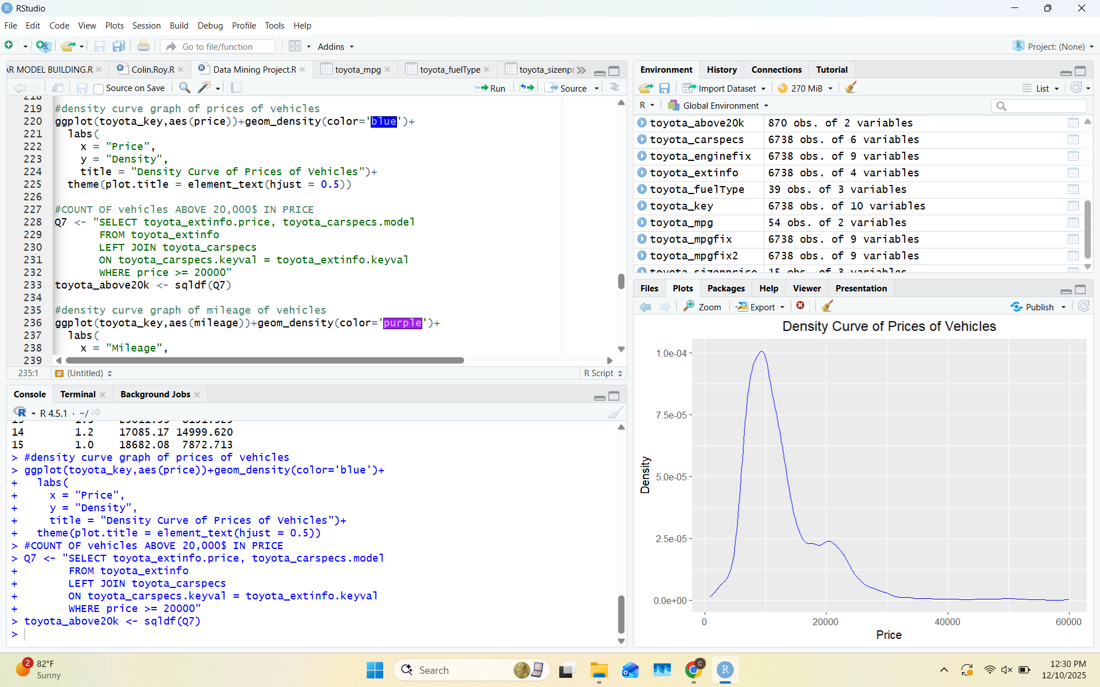
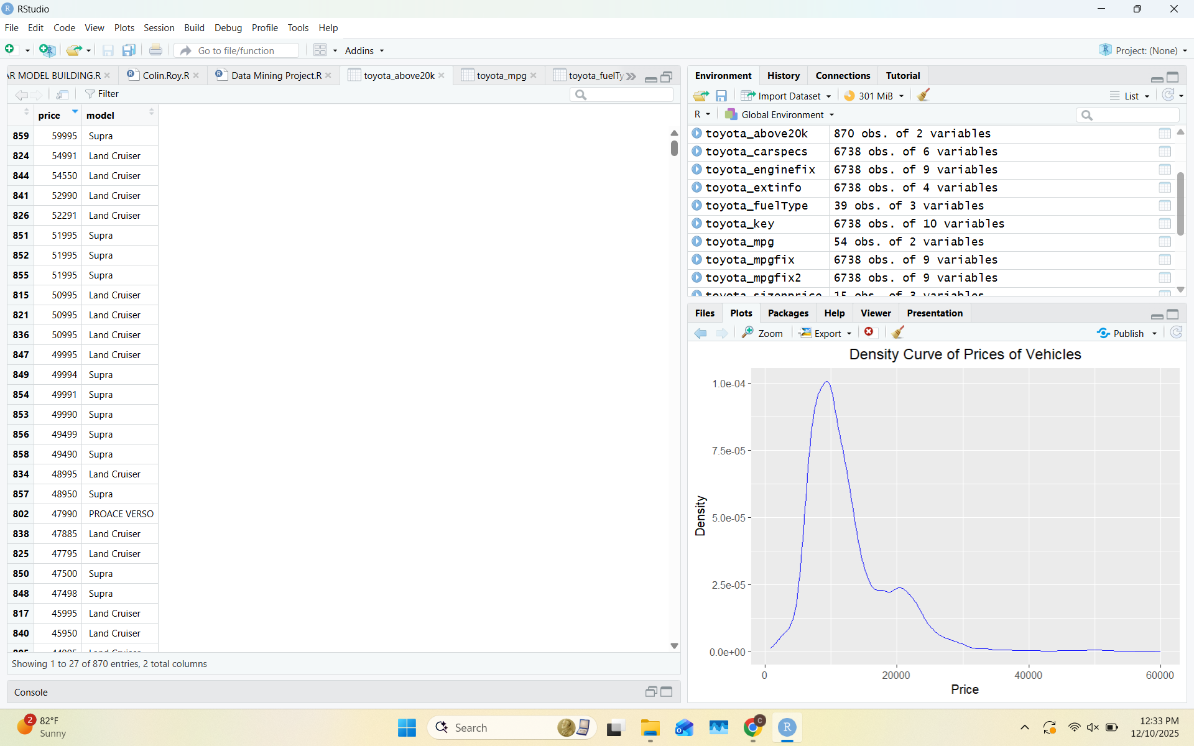
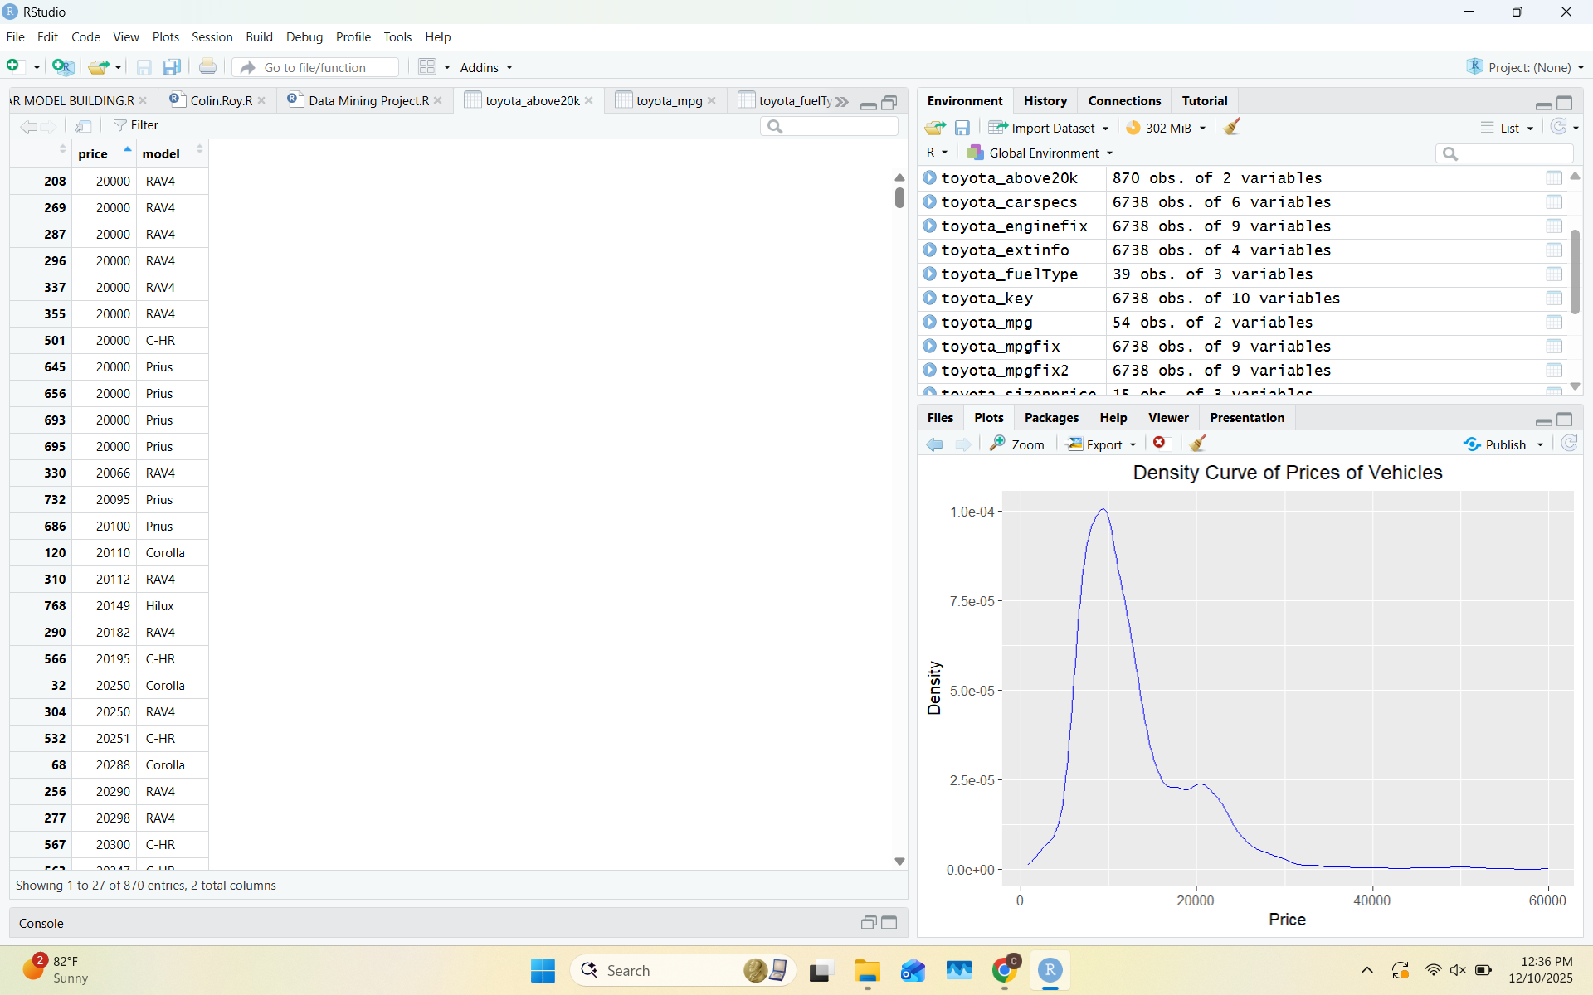
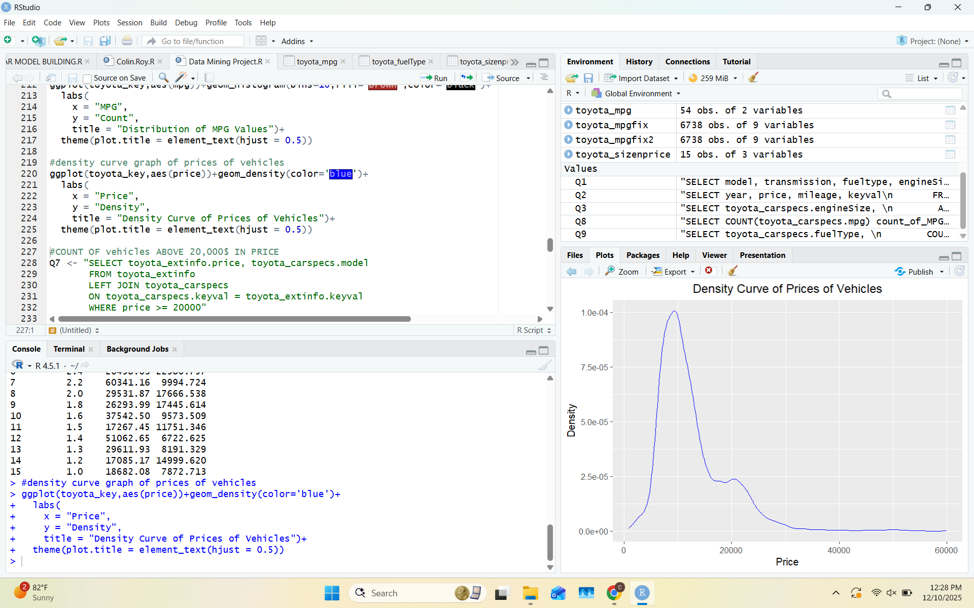
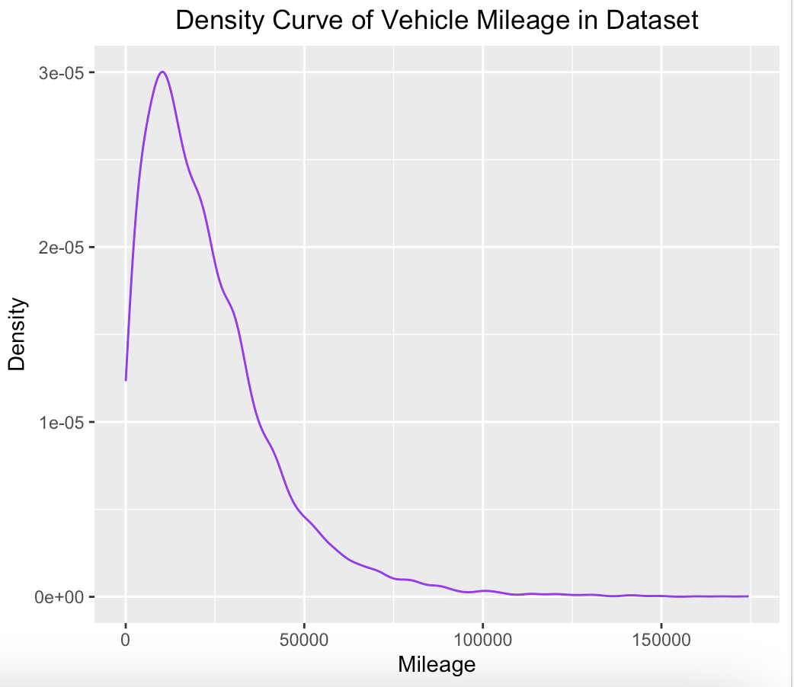
Visualization 5:
Supporting
Query:
Key Insight(s)
-Most vehicles have below 60,000 miles on the odometer
-most vehicles in the dataset are below 20,000$ in price
-870 models above 20,000$ in the dataset according to the query

Slide 12
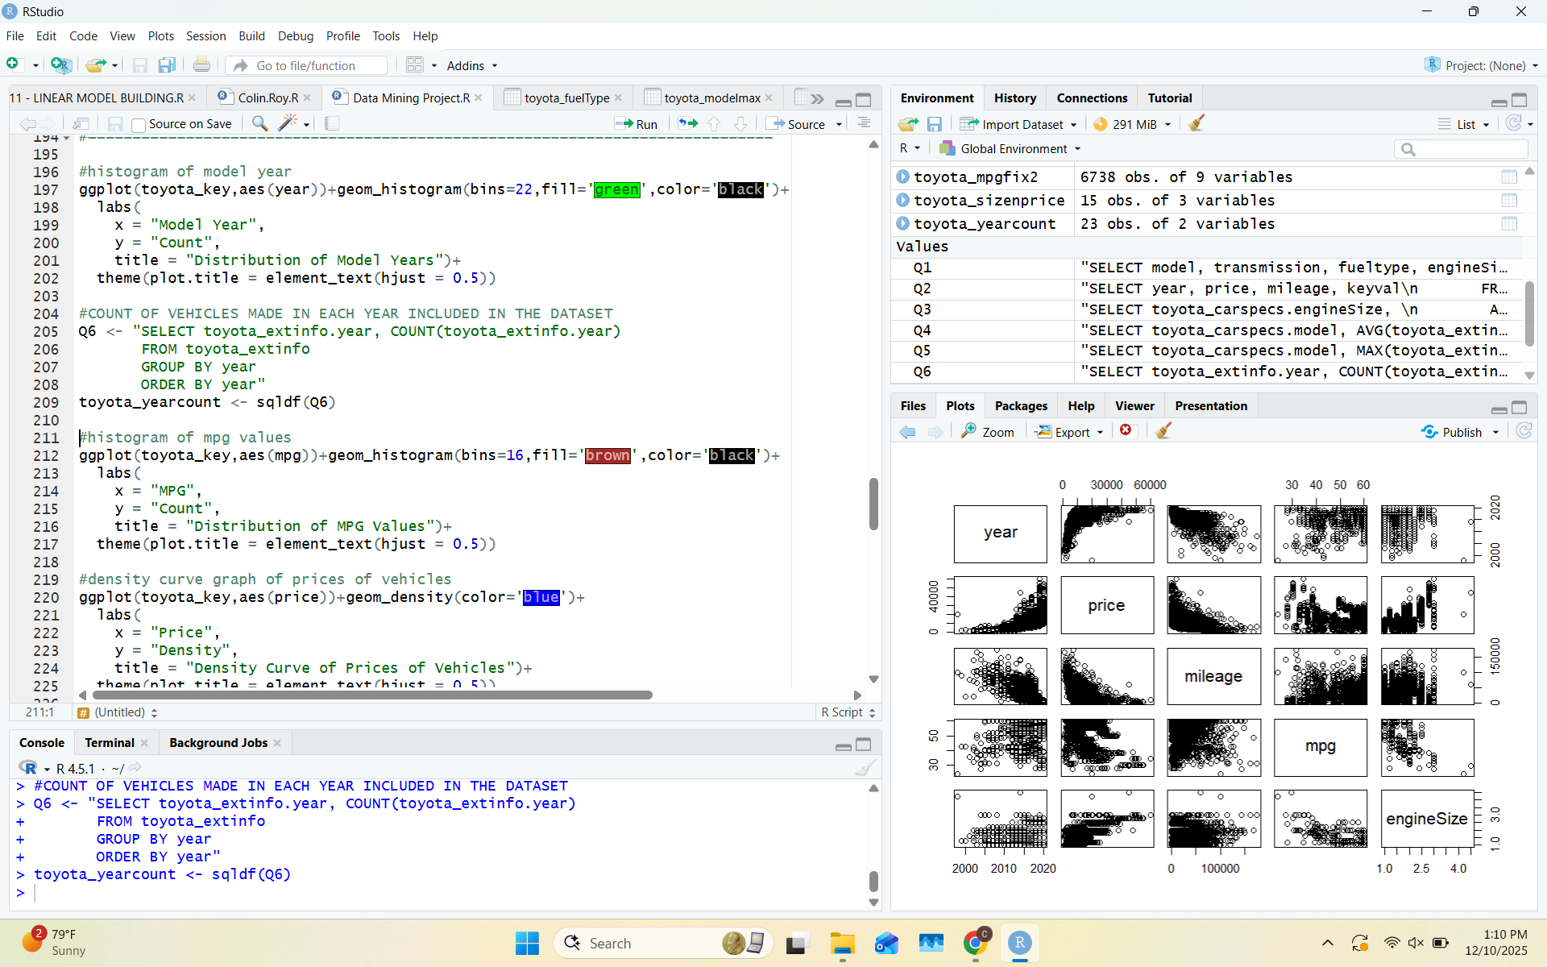
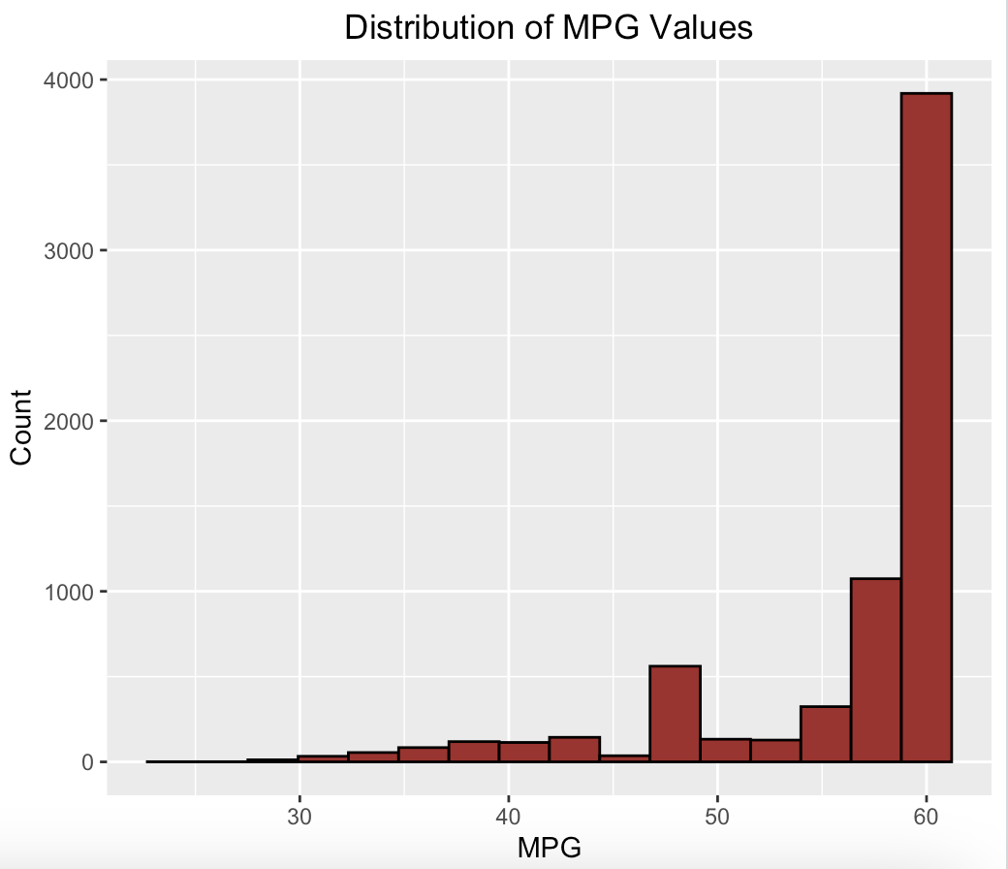
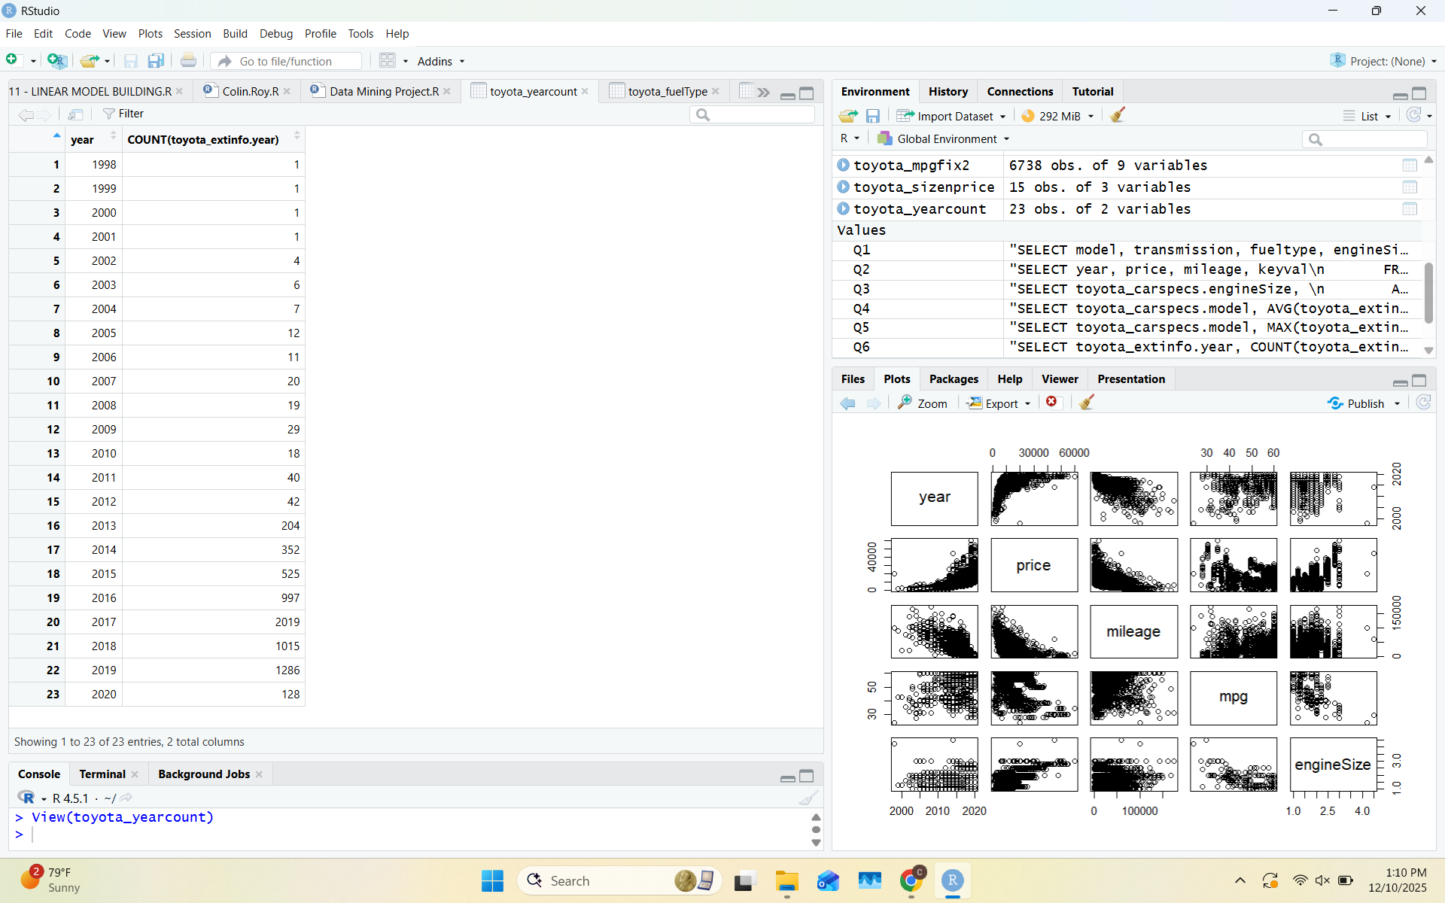
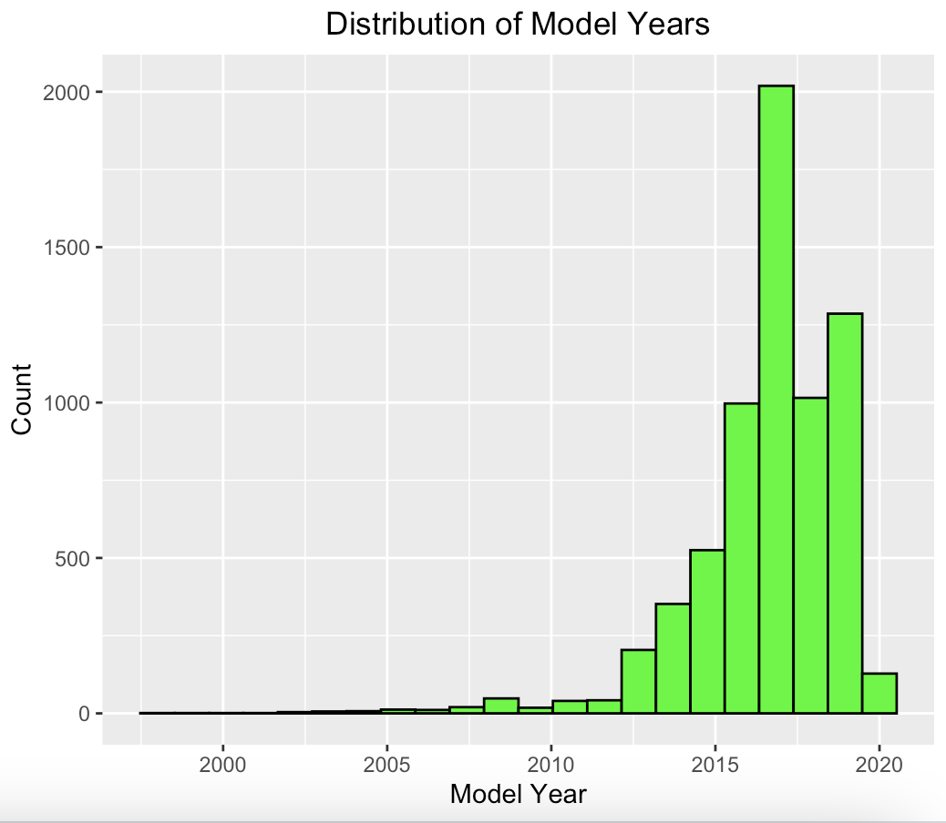
Visualization 6:
Supporting Query
Key Insight(s)
-Most vehicles in the dataset get very high miles per gallon
-exceeding majority of vehicles in the dataset are from 2013 and above
Key Insight(s)

Slide 13
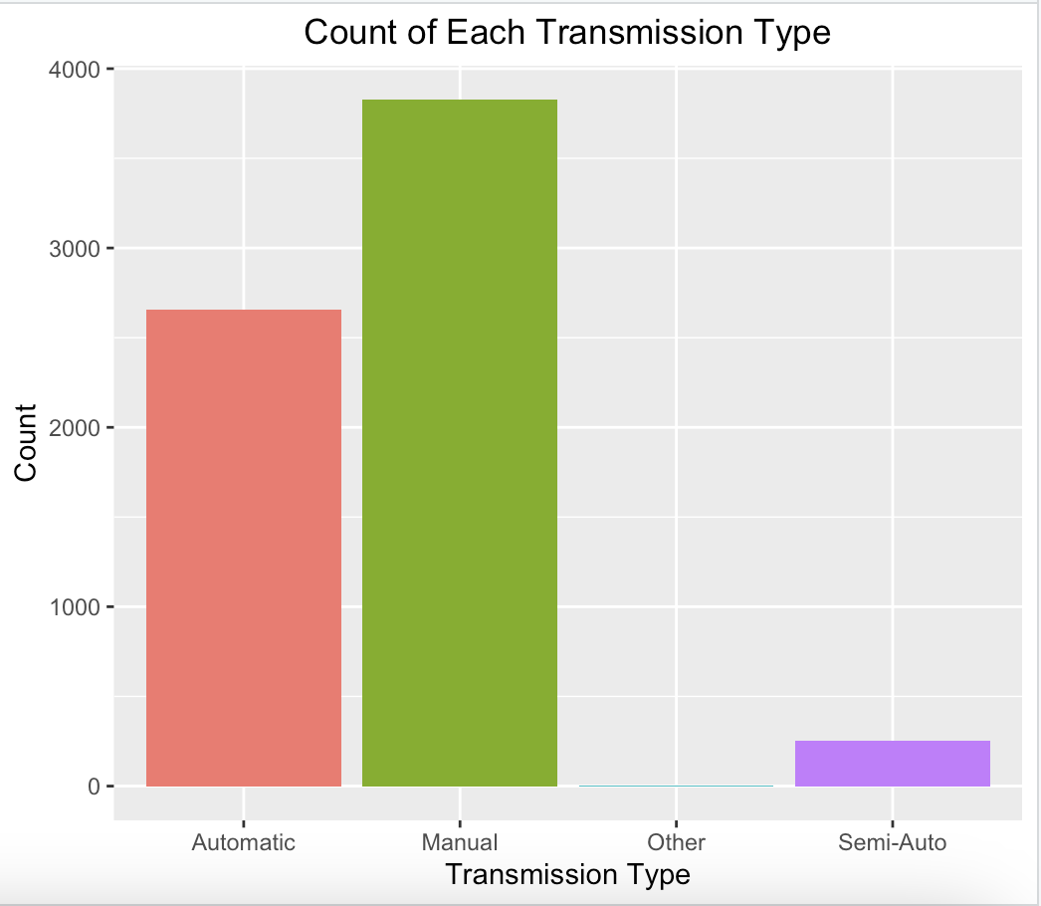
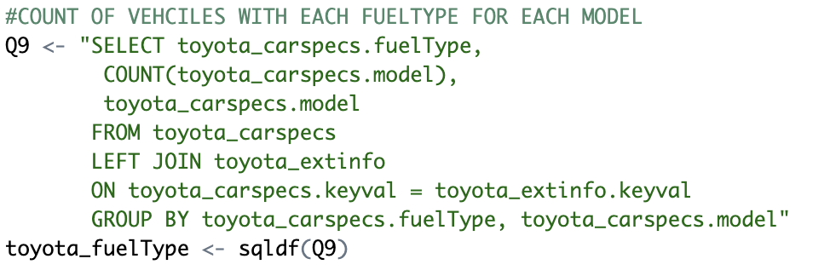
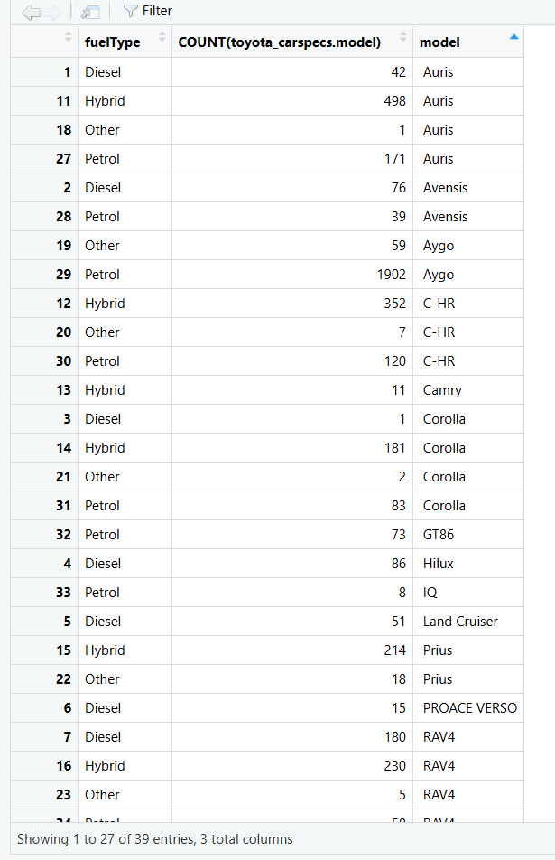
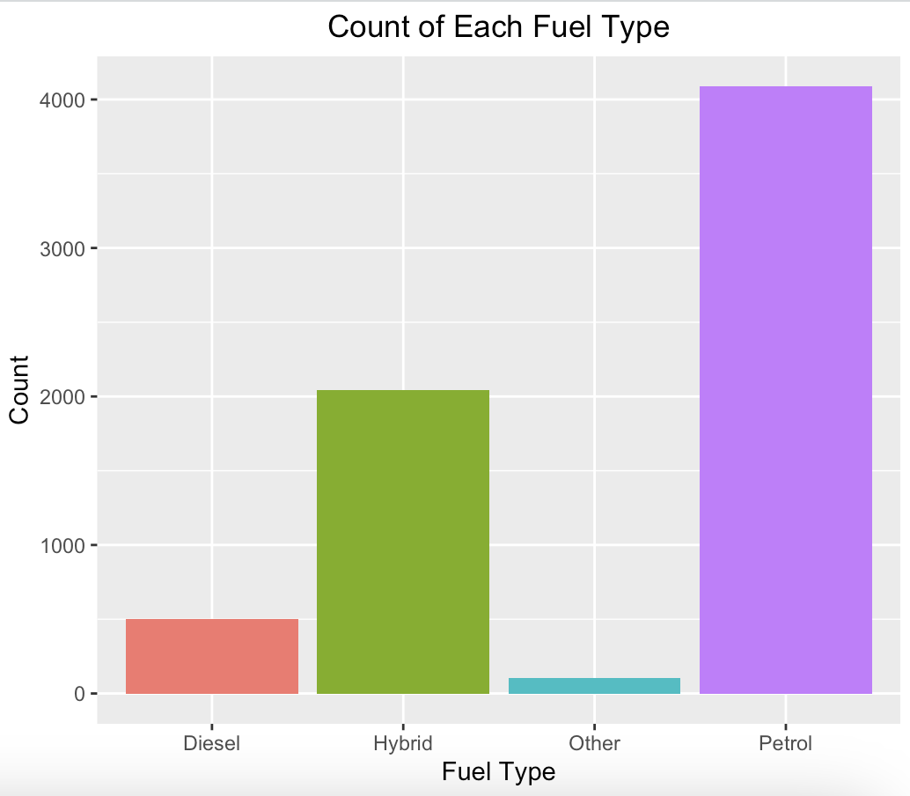
Visualization 7:
Supporting Query
Key Insight(s)
-Majority of vehicles have a manual, with the second most common transmission type being automatic
-Gas/petrol vehicles are the most common, with hybrids also being fairly common
-most vehicles have multiple fuel type options listed in the dataset

Slide 14
Predictive Analysis
Determining the Correlation Between Variables

Slide 15
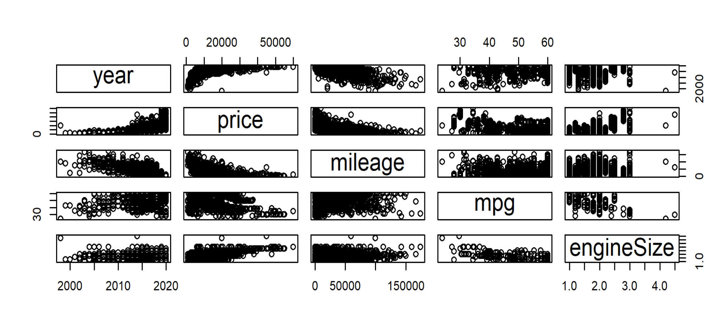
Correlation Matrix (Pairs)
Notes:
Daniel

Slide 16
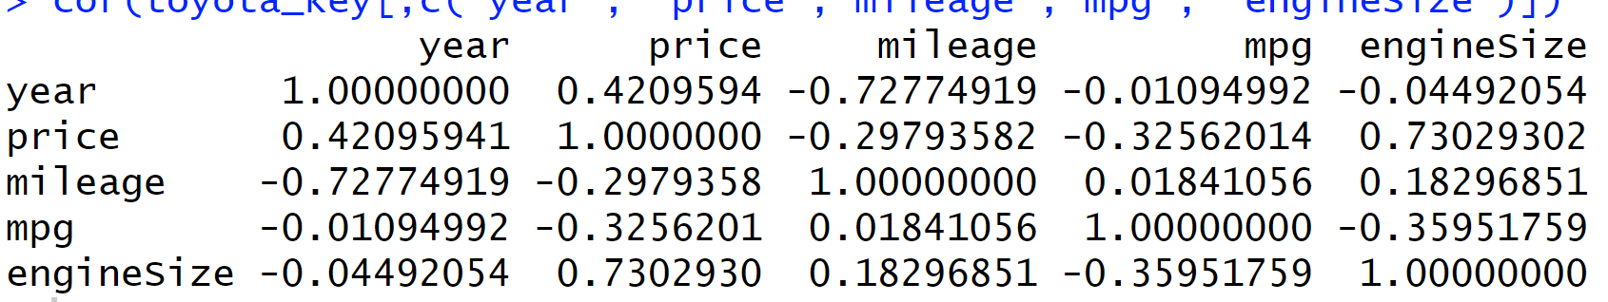
Correlation Matrix Cont’d (Pairs)
Key Insight(s)
Engine size is the strongest driver of price (+0.73)
Newer cars cost more (+0.42)
Newer cars naturally have lower mileage
(-0.73)
Notes:
Daniel

Slide 17
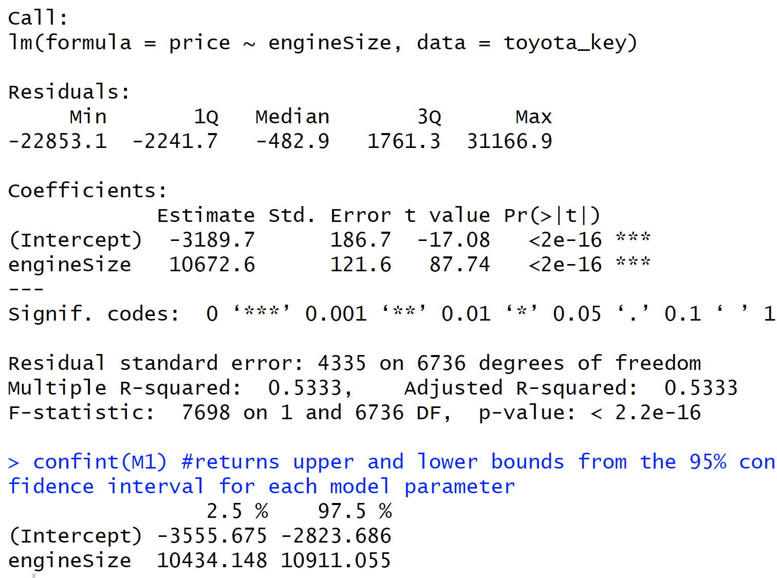
Correlation Matrix
Key Insight(s)
-The intercept: (-3,189.70) not a realistic dollar amount, would be ($0), but necessary to anchor the regression line
-Coefficient (Engine size): For every 1-liter increase in engine size, the model predicts an increase of about $10,673 in car price
-SIgnificance: Engine size is significant, this model explains %53 of the price variation
-Confidence Levels: We are 95% confident that the true increase in price per 1-liter engine size lies between $10.4k and $10.9k
Notes:
Daniel

Slide 18
Conclusion
1. Successful Data Cleaning
-Fixed inaccurate engine sizes, corrected unrealistic mpg values, and created a clean dataset with consistent numeric fields.
-Split toyota_key (final cleaned data) into toyota_carspecs and toyota_extinfo
3. Clear Price Drivers Identified
Engine size, mileage, and model type emerged as the strongest predictors of price.
4. Strong SQL + Visualization Integration
Using SQL summaries + ggplot visuals revealed patterns not visible in raw data (e.g., mpg clusters, year distribution, price differences).
5. Predictive Modeling Validated Insights
Engine size was one of the best predictors of price according to the linear model created
Notes:
Braden

